Slide 1

DIVINE GRACE COLLEGE OF ARTS, SCIENCE AND TECHNOLOGY
(DGCAST) — GAROUA | GEOGRAPHY DEPARTMENT
UPPER SIXTH ARTS — ECONOMIC GEOGRAPHY — FURTHER STUDY 7
Tourism Development in Cameroon
Mr KAMDEM EMMANUEL
Geography Teacher — PLEG
Academic Year 2026 / 2027
Notes:
Good morning, class. Today we study Further Study 7: Tourism Development in Cameroon.

Slide 2
GEOGRAPHY — UPPER SIXTH ARTS
CLASS INFO
Class, Chapter & Duration
Class | Upper Sixth Arts
Chapter | Module 6: Understanding and managing the dynamics of economic activities across the world in general and Cameroon in particular
Duration | 2 periods (2 × 50 minutes)
2026 / 2027
DGCAST GAROUA — GEOGRAPHY DEPARTMENT
Mr KAMDEM E. | 2

Slide 3
GEOGRAPHY — UPPER SIXTH ARTS
IDENTIFICATION
Lesson Identification
Topic | Geography of Cameroon
Sub-topic | Tourism in Cameroon
Lesson | Further Study 7: Tourism Development in Cameroon
Notions / Concepts | Tourist resource, national park, hotel, tourist circuit, Ministry of Tourism.
Syllabus focus | Natural and human resources and their distribution; tourist infrastructure; sources and destinations; problems; measures by individuals, communities and government; impacts.
Competence | Learners are able to describe tourism in Cameroon, its problems and ways to promote it.
2026 / 2027
DGCAST GAROUA — GEOGRAPHY DEPARTMENT
Mr KAMDEM E. | 3

Slide 4
GEOGRAPHY — UPPER SIXTH ARTS
OBJECTIVES
Learning Objectives
By the end of the lesson, the learner should be able to:
Describe the tourist resources and infrastructure of Cameroon.
Explain the problems of tourism.
Propose measures to promote tourism and assess its impacts.
2026 / 2027
DGCAST GAROUA — GEOGRAPHY DEPARTMENT
Mr KAMDEM E. | 4

Slide 5
GEOGRAPHY — UPPER SIXTH ARTS
RECALL
Recall
Cameroon is called "Africa in miniature".
Tourism brings jobs and money.
2026 / 2027
DGCAST GAROUA — GEOGRAPHY DEPARTMENT
Mr KAMDEM E. | 5

Slide 6
GEOGRAPHY — UPPER SIXTH ARTS
REAL-LIFE SITUATION
Real-Life Situation
Cameroon has beaches, mountains, parks and many cultures, yet it receives fewer tourists than Kenya or Morocco. The Ministry of Tourism wants to attract more visitors.
2026 / 2027
DGCAST GAROUA — GEOGRAPHY DEPARTMENT
Mr KAMDEM E. | 6
Notes:
Read the situation slowly, twice.

Slide 7
GEOGRAPHY — UPPER SIXTH ARTS
REAL-LIFE SITUATION
Situation — Question 1
What is the problem in the situation?
2026 / 2027
DGCAST GAROUA — GEOGRAPHY DEPARTMENT
Mr KAMDEM E. | 7

Slide 8
GEOGRAPHY — UPPER SIXTH ARTS
REAL-LIFE SITUATION
Answer
Cameroon has great potential but few tourists.
2026 / 2027
DGCAST GAROUA — GEOGRAPHY DEPARTMENT
Mr KAMDEM E. | 8

Slide 9
GEOGRAPHY — UPPER SIXTH ARTS
REAL-LIFE SITUATION
Situation — Question 2
Why is Cameroon called "Africa in miniature"?
2026 / 2027
DGCAST GAROUA — GEOGRAPHY DEPARTMENT
Mr KAMDEM E. | 9

Slide 10
GEOGRAPHY — UPPER SIXTH ARTS
REAL-LIFE SITUATION
Answer
It has nearly all the landscapes and cultures of Africa.
2026 / 2027
DGCAST GAROUA — GEOGRAPHY DEPARTMENT
Mr KAMDEM E. | 10

Slide 11
GEOGRAPHY — UPPER SIXTH ARTS
REAL-LIFE SITUATION
Situation — Question 3
Give one way to attract tourists.
2026 / 2027
DGCAST GAROUA — GEOGRAPHY DEPARTMENT
Mr KAMDEM E. | 11

Slide 12
GEOGRAPHY — UPPER SIXTH ARTS
REAL-LIFE SITUATION
Possible Answer
Advertise and improve security and roads.
2026 / 2027
DGCAST GAROUA — GEOGRAPHY DEPARTMENT
Mr KAMDEM E. | 12

Slide 13
GEOGRAPHY — UPPER SIXTH ARTS
JUSTIFICATION
Justification of the Lesson
This further study helps us to understand and promote tourism in Cameroon.
2026 / 2027
DGCAST GAROUA — GEOGRAPHY DEPARTMENT
Mr KAMDEM E. | 13

Slide 14
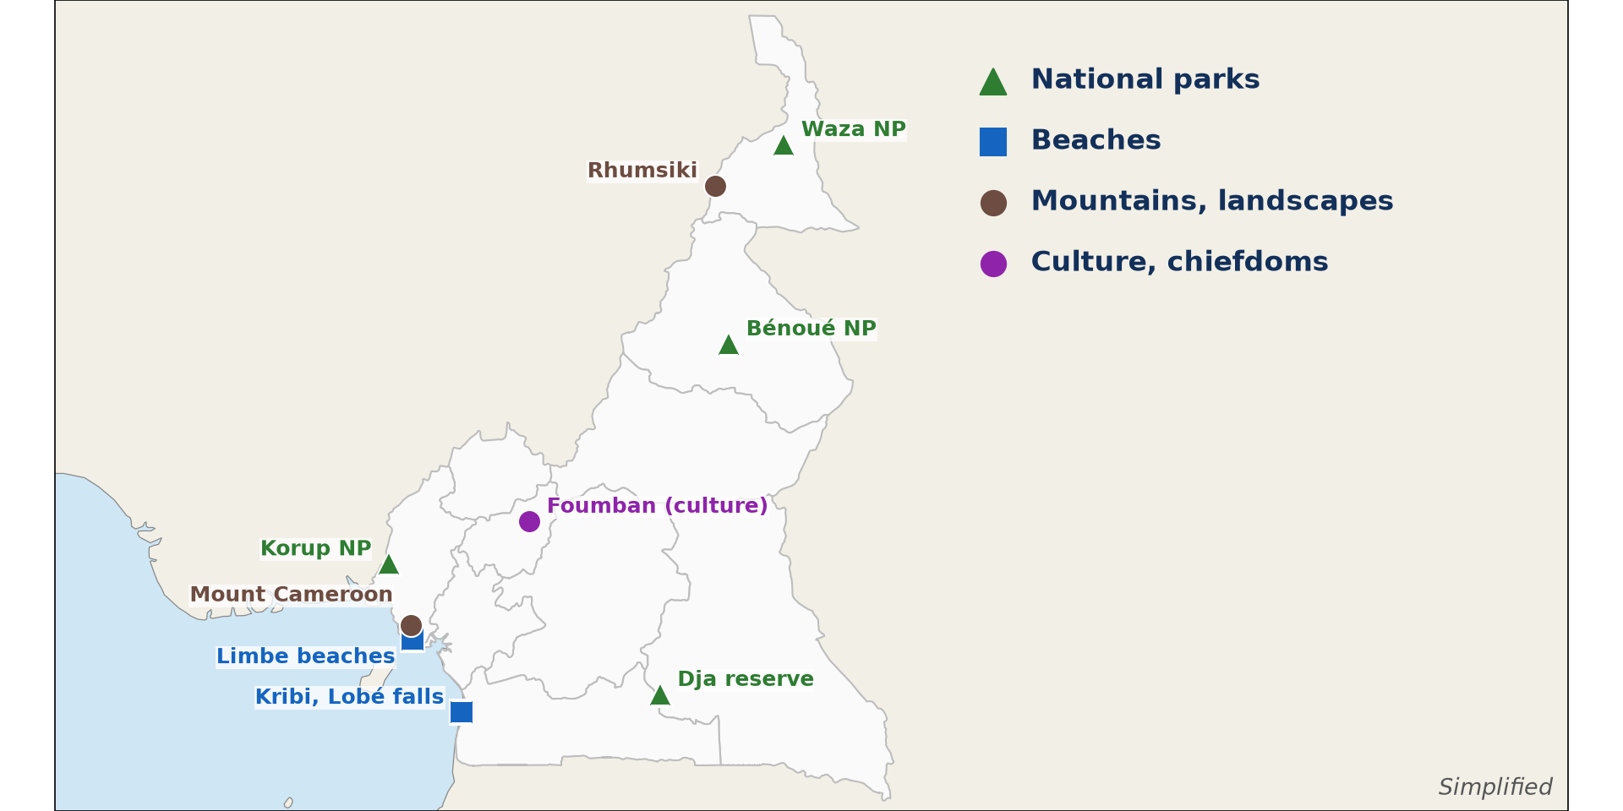
GEOGRAPHY — UPPER SIXTH ARTS
I. RESOURCES
Activity 1
Main tourist sites of Cameroon.
2026 / 2027
DGCAST GAROUA — GEOGRAPHY DEPARTMENT
Mr KAMDEM E. | 14
Notes:
Without the projector: read the map.

Slide 15
GEOGRAPHY — UPPER SIXTH ARTS
I. RESOURCES
Activity 1: Question
Give two natural tourist sites and their regions.
2026 / 2027
DGCAST GAROUA — GEOGRAPHY DEPARTMENT
Mr KAMDEM E. | 15

Slide 16
GEOGRAPHY — UPPER SIXTH ARTS
I. RESOURCES
Answer
Waza park (Far North) and Kribi beaches (South).
2026 / 2027
DGCAST GAROUA — GEOGRAPHY DEPARTMENT
Mr KAMDEM E. | 16

Slide 17
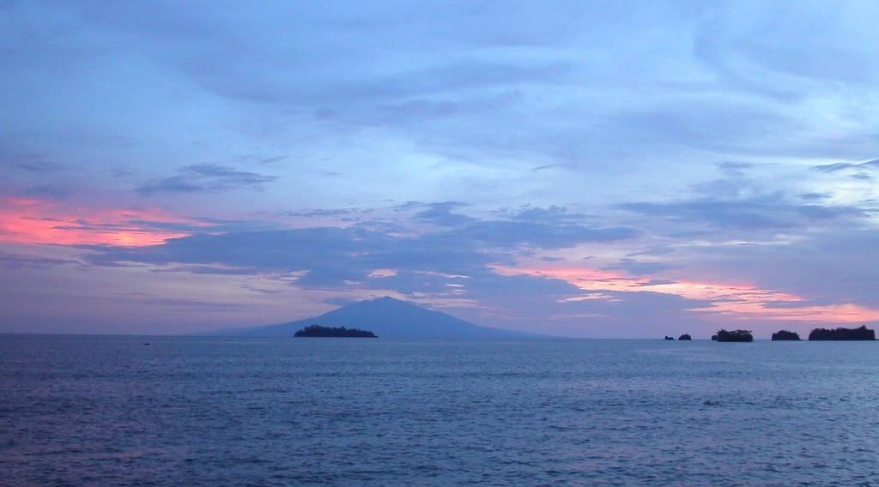
GEOGRAPHY — UPPER SIXTH ARTS
I. RESOURCES
Activity 2
Sunset at Limbe.
2026 / 2027
DGCAST GAROUA — GEOGRAPHY DEPARTMENT
Mr KAMDEM E. | 17
Notes:
Without the projector: list cultural sites.

Slide 18
GEOGRAPHY — UPPER SIXTH ARTS
I. RESOURCES
Activity 2: Question
Give two human (cultural) tourist resources.
2026 / 2027
DGCAST GAROUA — GEOGRAPHY DEPARTMENT
Mr KAMDEM E. | 18

Slide 19
GEOGRAPHY — UPPER SIXTH ARTS
I. RESOURCES
Answer
Chiefdoms like Bafut and Foumban, and festivals like Ngondo.
2026 / 2027
DGCAST GAROUA — GEOGRAPHY DEPARTMENT
Mr KAMDEM E. | 19

Slide 20
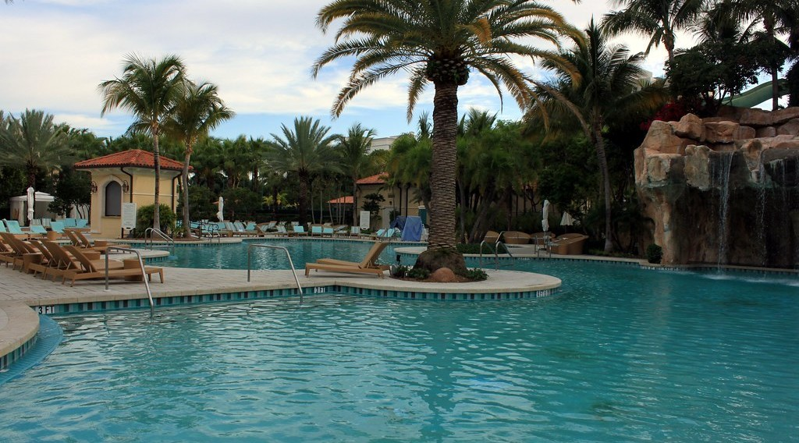
GEOGRAPHY — UPPER SIXTH ARTS
II. INFRASTRUCTURE
Activity 3
A hotel with a swimming pool.
2026 / 2027
DGCAST GAROUA — GEOGRAPHY DEPARTMENT
Mr KAMDEM E. | 20
Notes:
Without the projector: list hotels in your town.

Slide 21
GEOGRAPHY — UPPER SIXTH ARTS
II. INFRASTRUCTURE
Activity 3: Question
Name three types of tourist infrastructure.
2026 / 2027
DGCAST GAROUA — GEOGRAPHY DEPARTMENT
Mr KAMDEM E. | 21

Slide 22
GEOGRAPHY — UPPER SIXTH ARTS
II. INFRASTRUCTURE
Answer
Hotels, roads and airports (also travel agencies).
2026 / 2027
DGCAST GAROUA — GEOGRAPHY DEPARTMENT
Mr KAMDEM E. | 22

Slide 23

GEOGRAPHY — UPPER SIXTH ARTS
III. PROBLEMS
Activity 4
A bad road.
2026 / 2027
DGCAST GAROUA — GEOGRAPHY DEPARTMENT
Mr KAMDEM E. | 23
Notes:
Without the projector: list problems.

Slide 24
GEOGRAPHY — UPPER SIXTH ARTS
III. PROBLEMS
Activity 4: Question
Give three problems of tourism in Cameroon.
2026 / 2027
DGCAST GAROUA — GEOGRAPHY DEPARTMENT
Mr KAMDEM E. | 24

Slide 25
GEOGRAPHY — UPPER SIXTH ARTS
III. PROBLEMS
Answer
Bad roads, insecurity and poor advertising (also high costs).
2026 / 2027
DGCAST GAROUA — GEOGRAPHY DEPARTMENT
Mr KAMDEM E. | 25

Slide 26

GEOGRAPHY — UPPER SIXTH ARTS
IV. MEASURES AND IMPACTS
Activity 5
Wildlife in a national park.
2026 / 2027
DGCAST GAROUA — GEOGRAPHY DEPARTMENT
Mr KAMDEM E. | 26
Notes:
Without the projector: discuss community tourism.

Slide 27
GEOGRAPHY — UPPER SIXTH ARTS
IV. MEASURES AND IMPACTS
Activity 5: Question
How can local communities benefit from tourism?
2026 / 2027
DGCAST GAROUA — GEOGRAPHY DEPARTMENT
Mr KAMDEM E. | 27

Slide 28
GEOGRAPHY — UPPER SIXTH ARTS
IV. MEASURES AND IMPACTS
Answer
By selling crafts, guiding tourists and sharing park income.
2026 / 2027
DGCAST GAROUA — GEOGRAPHY DEPARTMENT
Mr KAMDEM E. | 28

Slide 29
GEOGRAPHY — UPPER SIXTH ARTS
BOARD SUMMARY
Tourism Development in Cameroon
Topic: Geography of Cameroon
Sub-topic: Tourism in Cameroon
Further Study 7: Tourism Development in Cameroon
2026 / 2027
DGCAST GAROUA — GEOGRAPHY DEPARTMENT
Mr KAMDEM E. | 29
Notes:
Learners copy the board summary now. Give them enough time for each slide.

Slide 30
GEOGRAPHY — UPPER SIXTH ARTS
BOARD SUMMARY
I. Definitions
Tourist resource: It is a natural or human feature that attracts tourists.
National park: It is a protected area for wildlife and nature, like Waza or Benue.
2026 / 2027
DGCAST GAROUA — GEOGRAPHY DEPARTMENT
Mr KAMDEM E. | 30

Slide 31
GEOGRAPHY — UPPER SIXTH ARTS
BOARD SUMMARY
II. Resources and Infrastructure (1/3)
A. Natural resources: Beaches at Kribi and Limbe, Mount Cameroon and parks like Waza and Benue attract visitors. Waterfalls like Lobé are also attractions.
B. Human resources: Chiefdoms, palaces and festivals show rich cultures. Foumban, Bafut and Rhumsiki are famous.
2026 / 2027
DGCAST GAROUA — GEOGRAPHY DEPARTMENT
Mr KAMDEM E. | 31

Slide 32
GEOGRAPHY — UPPER SIXTH ARTS
BOARD SUMMARY
II. Resources and Infrastructure (2/3)
C. Infrastructure: Hotels, airports and roads are concentrated in big towns. The Ministry of Tourism manages the sector.
D. Tourists: Most tourists come from France, other European countries and Africa. Business tourism is common in Douala and Yaoundé.
2026 / 2027
DGCAST GAROUA — GEOGRAPHY DEPARTMENT
Mr KAMDEM E. | 32

Slide 33
GEOGRAPHY — UPPER SIXTH ARTS
BOARD SUMMARY
II. Resources and Infrastructure (3/3)
Sketch the tourist sites.
2026 / 2027
DGCAST GAROUA — GEOGRAPHY DEPARTMENT
Mr KAMDEM E. | 33

Slide 34
GEOGRAPHY — UPPER SIXTH ARTS
BOARD SUMMARY
III. Problems, Measures and Impacts (1/2)
A. Problems: Bad roads, insecurity and poor advertising limit tourism. Hotels are costly and few in rural areas.
B. Measures: The government can improve roads, security and advertising. Communities and individuals can welcome and guide visitors.
2026 / 2027
DGCAST GAROUA — GEOGRAPHY DEPARTMENT
Mr KAMDEM E. | 34

Slide 35
GEOGRAPHY — UPPER SIXTH ARTS
BOARD SUMMARY
III. Problems, Measures and Impacts (2/2)
C. Impacts: Tourism brings jobs, income and pride in culture. It can also pollute sites and disturb wildlife.
2026 / 2027
DGCAST GAROUA — GEOGRAPHY DEPARTMENT
Mr KAMDEM E. | 35

Slide 36
GEOGRAPHY — UPPER SIXTH ARTS
FORMATIVE EVALUATION
Formative Evaluation 1
Give two natural and two cultural tourist resources of Cameroon.
2026 / 2027
DGCAST GAROUA — GEOGRAPHY DEPARTMENT
Mr KAMDEM E. | 36

Slide 37
GEOGRAPHY — UPPER SIXTH ARTS
FORMATIVE EVALUATION
Expected Answer
Natural: Waza, Kribi. Cultural: Foumban palace, Ngondo festival.
2026 / 2027
DGCAST GAROUA — GEOGRAPHY DEPARTMENT
Mr KAMDEM E. | 37

Slide 38
GEOGRAPHY — UPPER SIXTH ARTS
FORMATIVE EVALUATION
Formative Evaluation 2
Give two measures to promote tourism in Cameroon.
2026 / 2027
DGCAST GAROUA — GEOGRAPHY DEPARTMENT
Mr KAMDEM E. | 38

Slide 39
GEOGRAPHY — UPPER SIXTH ARTS
FORMATIVE EVALUATION
Expected Answer
Improve roads and security; advertise abroad.
2026 / 2027
DGCAST GAROUA — GEOGRAPHY DEPARTMENT
Mr KAMDEM E. | 39

Slide 40
GEOGRAPHY — UPPER SIXTH ARTS
REMEDIATION
Remediation
Fill in the blanks:
Waza park is in the ______ Region.
The beaches of ______ are in the South Region.
Tourism is managed by the Ministry of ______.
2026 / 2027
DGCAST GAROUA — GEOGRAPHY DEPARTMENT
Mr KAMDEM E. | 40
Notes:
Answers: 1. Far North 2. Kribi 3. Tourism

Slide 41
GEOGRAPHY — UPPER SIXTH ARTS
HOMEWORK
Homework
Prepare a short advertisement for a tourist site in your region.
This ends Module 6 and prepares Module 7: Environment and Development.
2026 / 2027
DGCAST GAROUA — GEOGRAPHY DEPARTMENT
Mr KAMDEM E. | 41
Notes:
This homework prepares the next lesson.

Slide 42
GEOGRAPHY — UPPER SIXTH ARTS
BILINGUAL GAME
Bilingual Game (Jeu Bilingue)
English | Français
National park | Le parc national
Chiefdom | La chefferie
Festival | Le festival
Craft | L'artisanat
Guide | Le guide
Advertising | La publicité
2026 / 2027
DGCAST GAROUA — GEOGRAPHY DEPARTMENT
Mr KAMDEM E. | 42
Notes:
Say the English word; learners give the French word, then the reverse.

Slide 43
GEOGRAPHY — UPPER SIXTH ARTS
LOGBOOK
Official Logbook (1/2)
Module / Topic | Geography of Cameroon
Lesson Title | Further Study 7: Tourism Development in Cameroon
Expected Learning Outcomes | Describe the tourist resources and infrastructure of Cameroon. Explain the problems of tourism. Propose measures to promote tourism and assess its impacts.
Competence | Learners are able to describe tourism in Cameroon, its problems and ways to promote it.
2026 / 2027
DGCAST GAROUA — GEOGRAPHY DEPARTMENT
Mr KAMDEM E. | 43

Slide 44
GEOGRAPHY — UPPER SIXTH ARTS
LOGBOOK
Official Logbook (2/2)
Matter Taught | I. Definitions: Tourist resource, National park; II. Resources and Infrastructure: Natural resources, Human resources, Infrastructure, Tourists; III. Problems, Measures and Impacts: Problems, Measures, Impacts.
Evaluation | Formative evaluation (3 questions) and remediation exercise.
Homework | Prepare a short advertisement for a tourist site in your region.
Enrolment / Present / Absent | ____ / ____ / ____
Achievement | To be completed by the teacher after the lesson.
2026 / 2027
DGCAST GAROUA — GEOGRAPHY DEPARTMENT
Mr KAMDEM E. | 44

Slide 45
GEOGRAPHY — UPPER SIXTH ARTS
TEACHER'S NOTE
Teacher's Note
Timing: Set-up, recall 8 min | Situation 8 min | 5 activities 30 min | Board summary (copying) 30 min | Evaluation, remediation 10 min | Homework, logbook 9 min | Spare 5 min
2026 / 2027
DGCAST GAROUA — GEOGRAPHY DEPARTMENT
Mr KAMDEM E. | 45

Slide 46
GEOGRAPHY — UPPER SIXTH ARTS
REFERENCES
References
National Geography Syllabus, Sixth Forms (Lower & Upper Sixth), MINESEC/IGE/IP-SS, August 2019 — Module 6 (Economic Geography).
Photo, Activity 2: “Sunset in Limbe” by visulogik, CC BY 2.0, via Flickr (https://www.flickr.com/photos/55671677@N00/2202334428)
Photo, Activity 3: “Laguna Pool” by Prayitno / Thank you for (12 millions +) view, CC BY 2.0, via Flickr (https://www.flickr.com/photos/34128007@N04/14216582552)
Photo, Activity 4: “Cameroon - UN Women's Gender Road Project” by UN Women Gallery, CC BY-NC-ND 2.0, via Flickr (https://www.flickr.com/photos/51431730@N04/40672356003)
Photo, Activity 5: “African Bush Elephants, Maasai Mara” by Ray in Manila, CC BY 2.0, via Flickr (https://www.flickr.com/photos/21186555@N07/50627864261)
Diagrams and animations: drawn for this lesson (DGCAST Geography Department).
2026 / 2027
DGCAST GAROUA — GEOGRAPHY DEPARTMENT
Mr KAMDEM E. | 46

